Slide 1

Forward Propagation
Professor Bo Liu
James Watt School of Engineering

Slide 2







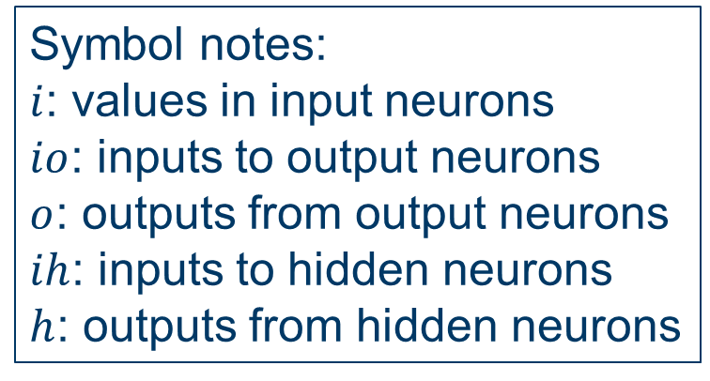




Forward propagation
Input: [0.35, 0.9]
Expected output: [0.5]
Activation function: Sigmoid
Note: Activation function does not apply to the input layer.
Input layer
Hidden layer
Output layer
$$i_{1}$$
$$h_{1}$$
$$w_{1}$$
?
Input 1
0.35
0.1
$$w_{5}$$
Symbol notes:
$i$: values in input neurons
$io$: inputs to output neurons
$o$: outputs from output neurons
$ih$: inputs to hidden neurons
$h$: outputs from hidden neurons
$$w_{2}$$
0.3
$$o_{1}$$
0.4
?
$$w_{3}$$
Output
$$i_{2}$$
0.8
$$h_{2}$$
Input 2
$$w_{4}$$
?
$$w_{6}$$
0.9
0.9
0.6

Slide 3
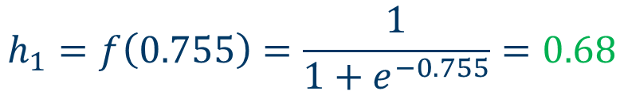
Forward propagation
Input: [0.35, 0.9]
Expected output: [0.5]
Activation function: Sigmoid
$${ih}_{1}=0.35×0.1+0.9×0.8=0.755$$
$$h_{1}=f\left(0.755\right)=\frac{1}{1+e^{−0.755}}=0.68$$
Input layer
Hidden layer
Output layer
$$i_{1}$$
$$h_{1}$$
$$w_{1}$$
Input 1
0.35
0.1
$$w_{5}$$
Symbol notes:
$i$: values in input neurons
$io$: inputs to output neurons
$o$: outputs from output neurons
$ih$: inputs to hidden neurons
$h$: outputs from hidden neurons
0.68
0.3
$$w_{2}$$
$$o_{1}$$
0.4
$$w_{3}$$
Output
$$i_{2}$$
0.8
$$h_{2}$$
Input 2
$$w_{4}$$
$$w_{6}$$
0.9
0.9
0.6

Slide 4
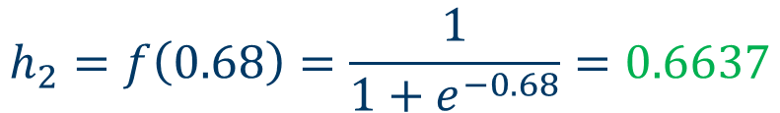
Forward propagation
Input: [0.35, 0.9]
Expected output: [0.5]
Activation function: Sigmoid
$${ih}_{2}=0.35×0.4+0.9×0.6=0.68$$
$$h_{2}=f\left(0.68\right)=\frac{1}{1+e^{−0.68}}=0.6637$$
Input layer
Hidden layer
Output layer
$$i_{1}$$
$$h_{1}$$
$$w_{1}$$
Input 1
0.35
0.1
0.68
$$w_{5}$$
Symbol notes:
$i$: values in input neurons
$io$: inputs to output neurons
$o$: outputs from output neurons
$ih$: inputs to hidden neurons
$h$: outputs from hidden neurons
$$w_{2}$$
0.3
$$o_{1}$$
0.4
$$w_{3}$$
Output
$$i_{2}$$
0.8
$$h_{2}$$
Input 2
$$w_{4}$$
$$w_{6}$$
0.9
0.6637
0.9
0.6

Slide 5
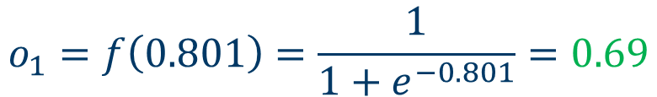
Forward propagation
Input: [0.35, 0.9]
Expected output: [0.5]
Activation function: Sigmoid
$${io}_{1}=0.68×0.3+0.6637×0.9=0.801$$
$$o_{1}=f\left(0.801\right)=\frac{1}{1+e^{−0.801}}=0.69$$
Input layer
Hidden layer
Output layer
$$i_{1}$$
$$h_{1}$$
$$w_{1}$$
Input 1
0.35
0.1
$$w_{5}$$
Symbol notes:
$i$: values in input neurons
$io$: inputs to output neurons
$o$: outputs from output neurons
$ih$: inputs to hidden neurons
$h$: outputs from hidden neurons
0.68
0.3
$$w_{2}$$
$$o_{1}$$
0.4
$$w_{3}$$
0.69
Output
$$i_{2}$$
0.8
$$h_{2}$$
Input 2
$$w_{4}$$
$$w_{6}$$
0.9
0.6637
0.9
0.6

Slide 6




Thanks!
#UofGWorldChangers
@UofGlasgow

